Slide 1



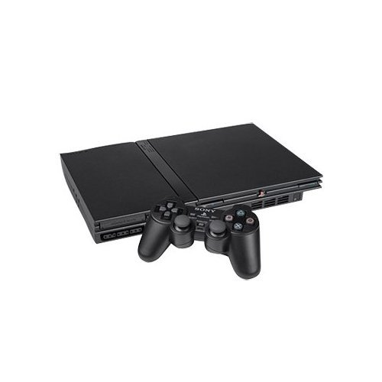

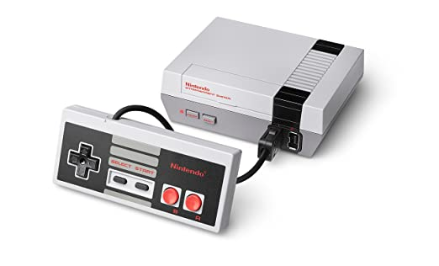
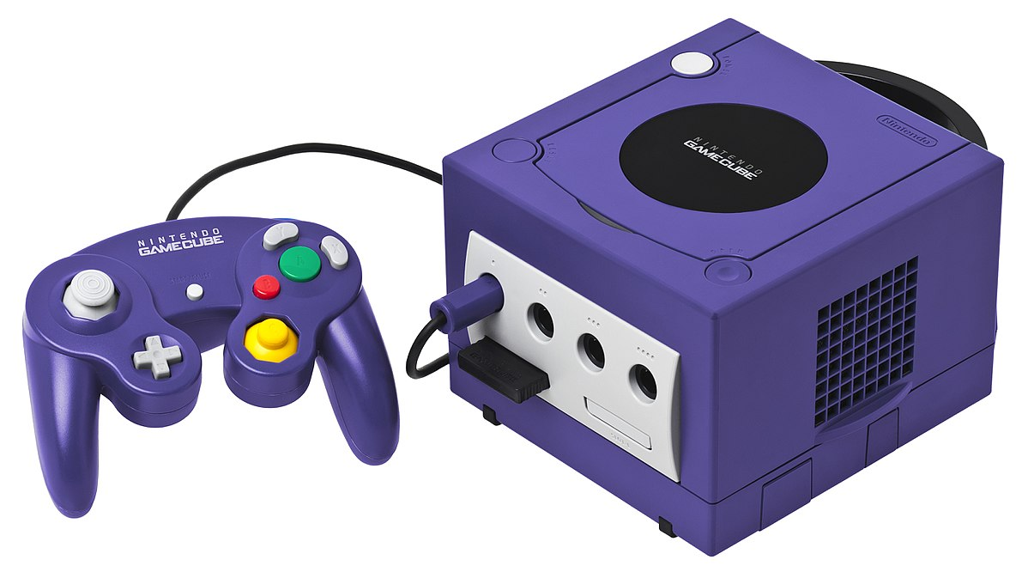
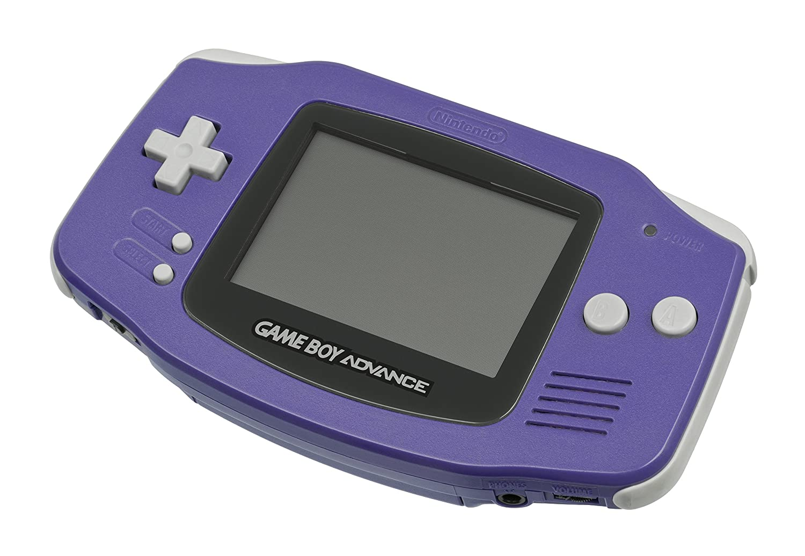
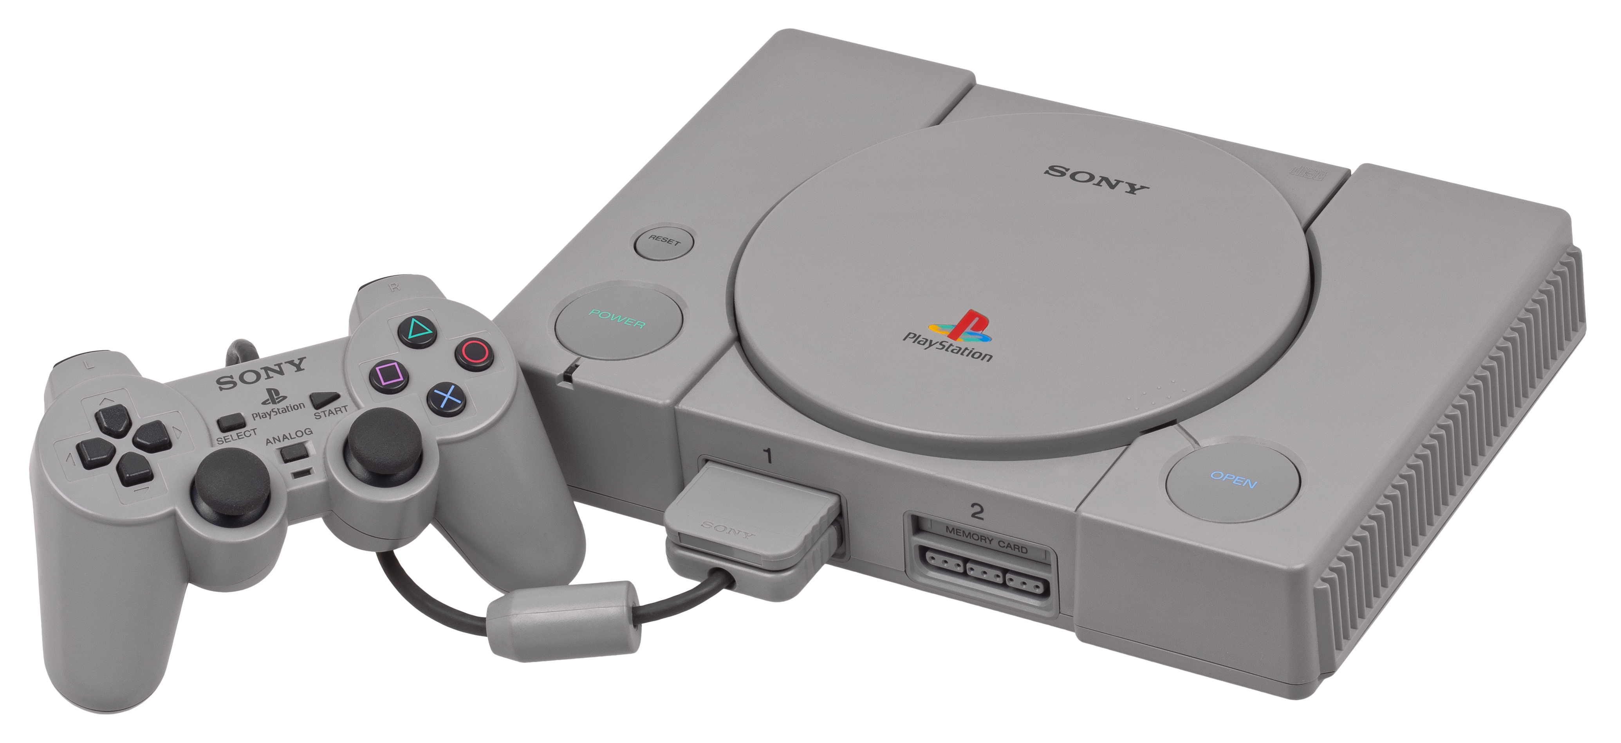
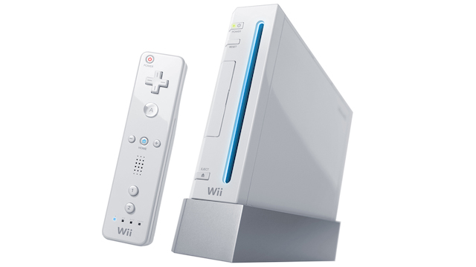
Video Game Sales
Final Project for ALY6000 2/26/21
John DiSessa

Slide 2

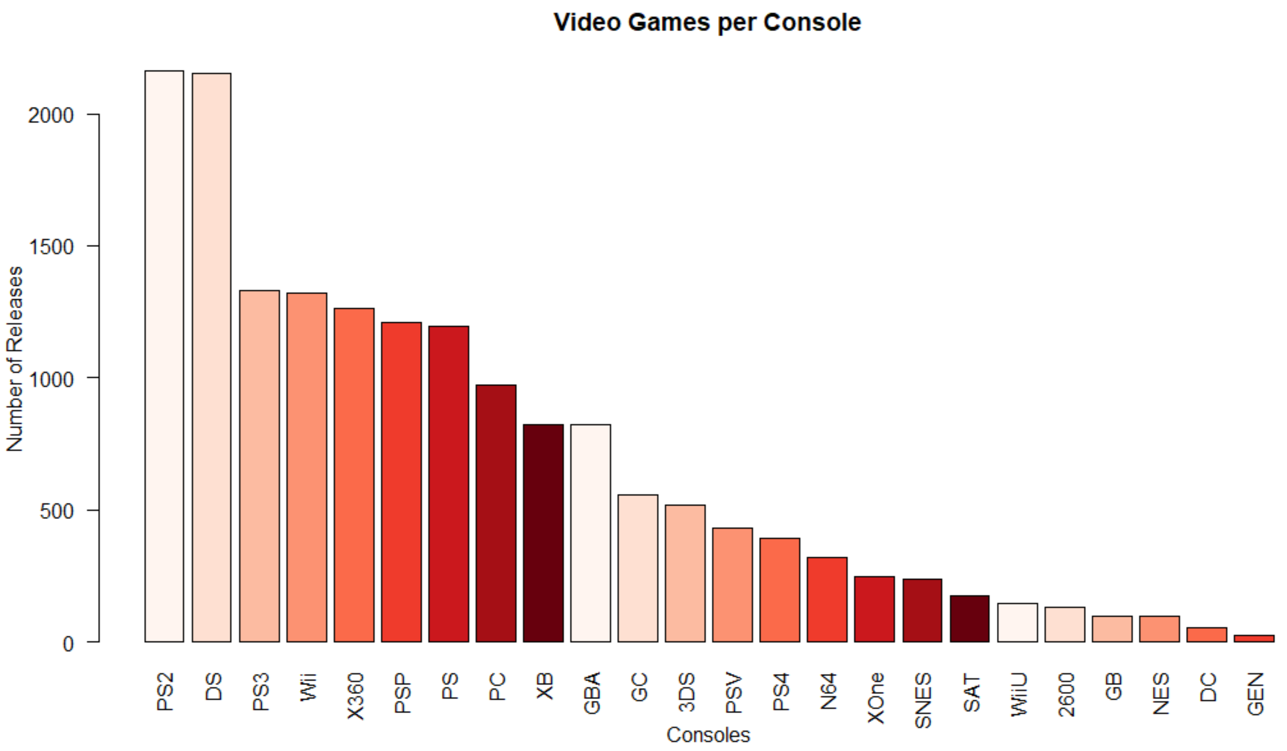
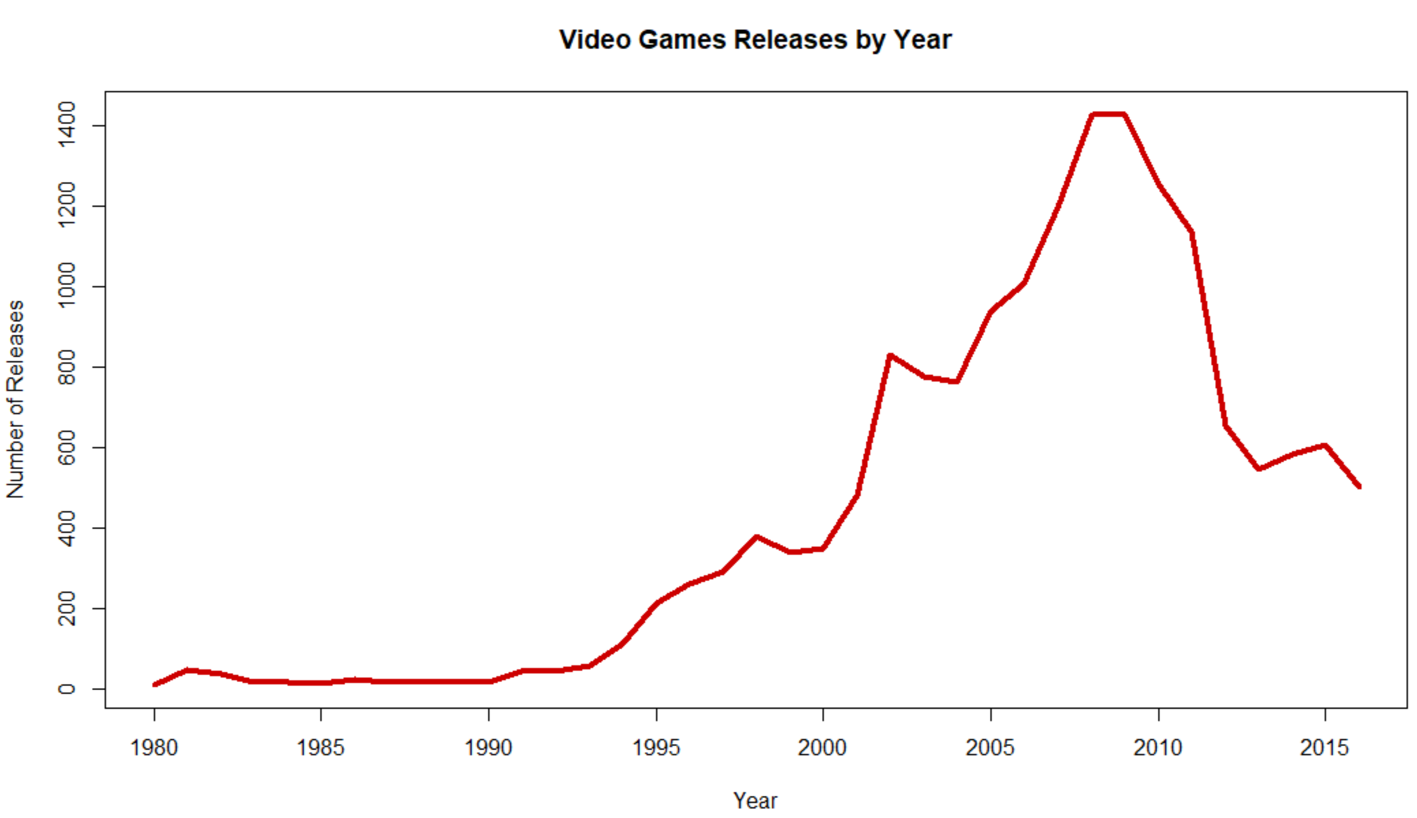
Data Summary
Avg Sales per Game | Mean | Median
North America | $263,700 | $80,000
Europe | $145,300 | $20,000
Japan | $77,500 | $1,000
Video Game sales data 1980 – 2016
579 publishers, 12 genres, 16,681 releases
Sales skewed by few big hits
Notes:
Right-skewed, mean is far greater than median, indicated a few big outliers skew the sales data. I created a new variable of Total_Sales for these and future calculations.

Slide 3
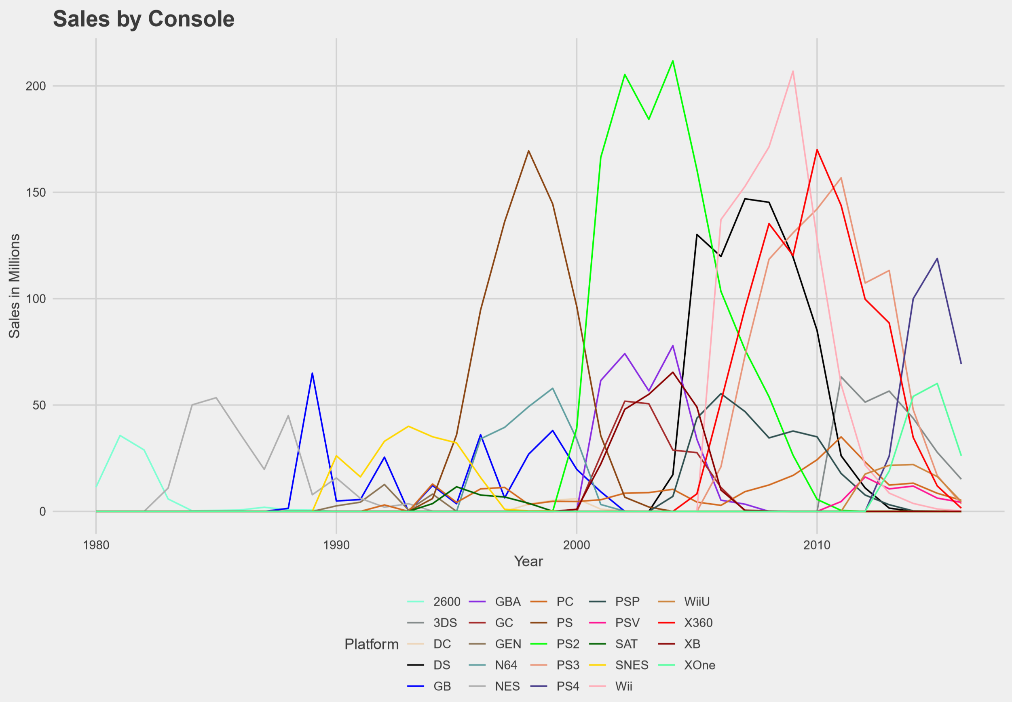
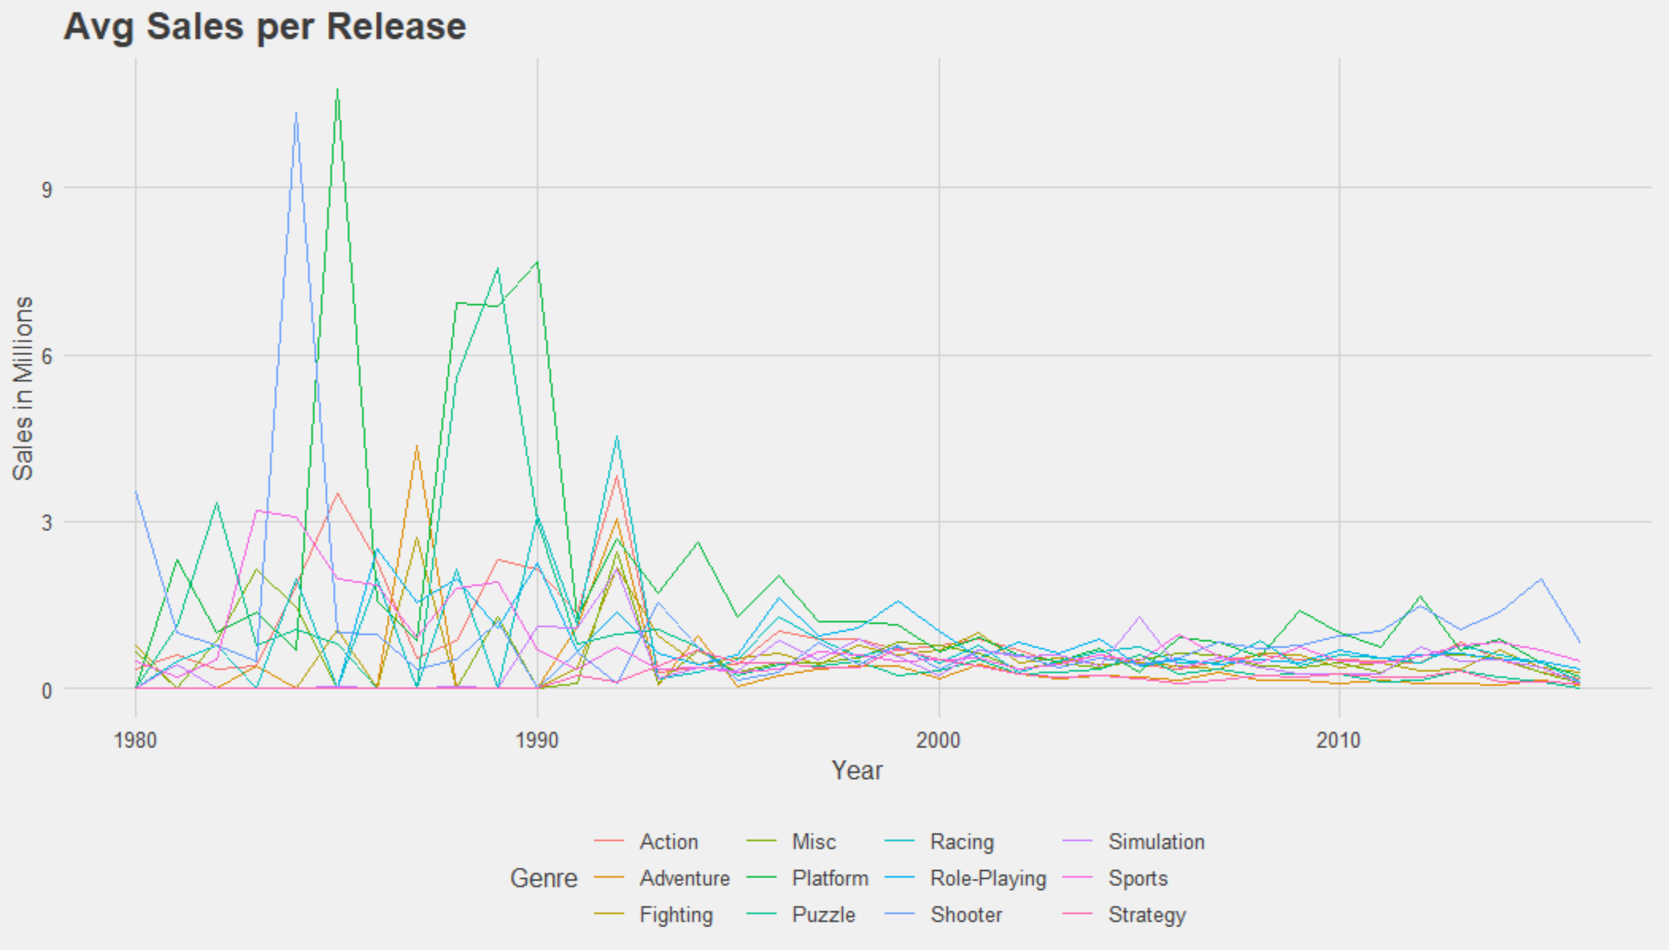
Competition
New Entrants > Consumer Demand
Notes:
There is an inflection point around 1995 where many new creators entered the market. More games and more platforms were released but consumer demand did not meet the supply. Thus, profitability per game has been steadily low since 1995. The Sales by Console graph shows sales over time by each major console. It is interesting to see the peaks of different consoles and how consumers tend to prefer one or two consoles in any given period.

Slide 4
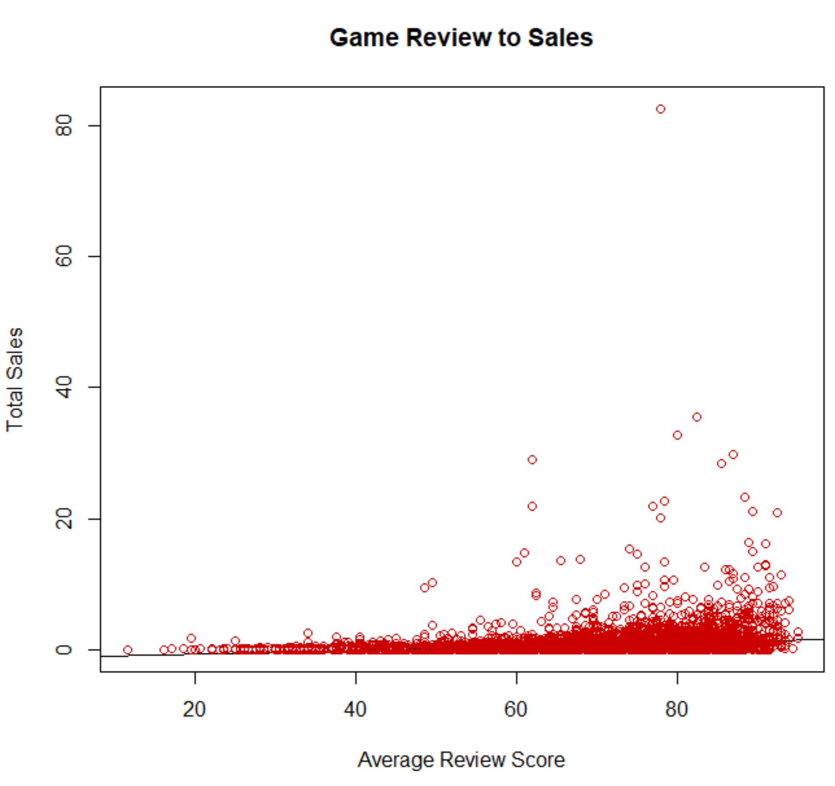
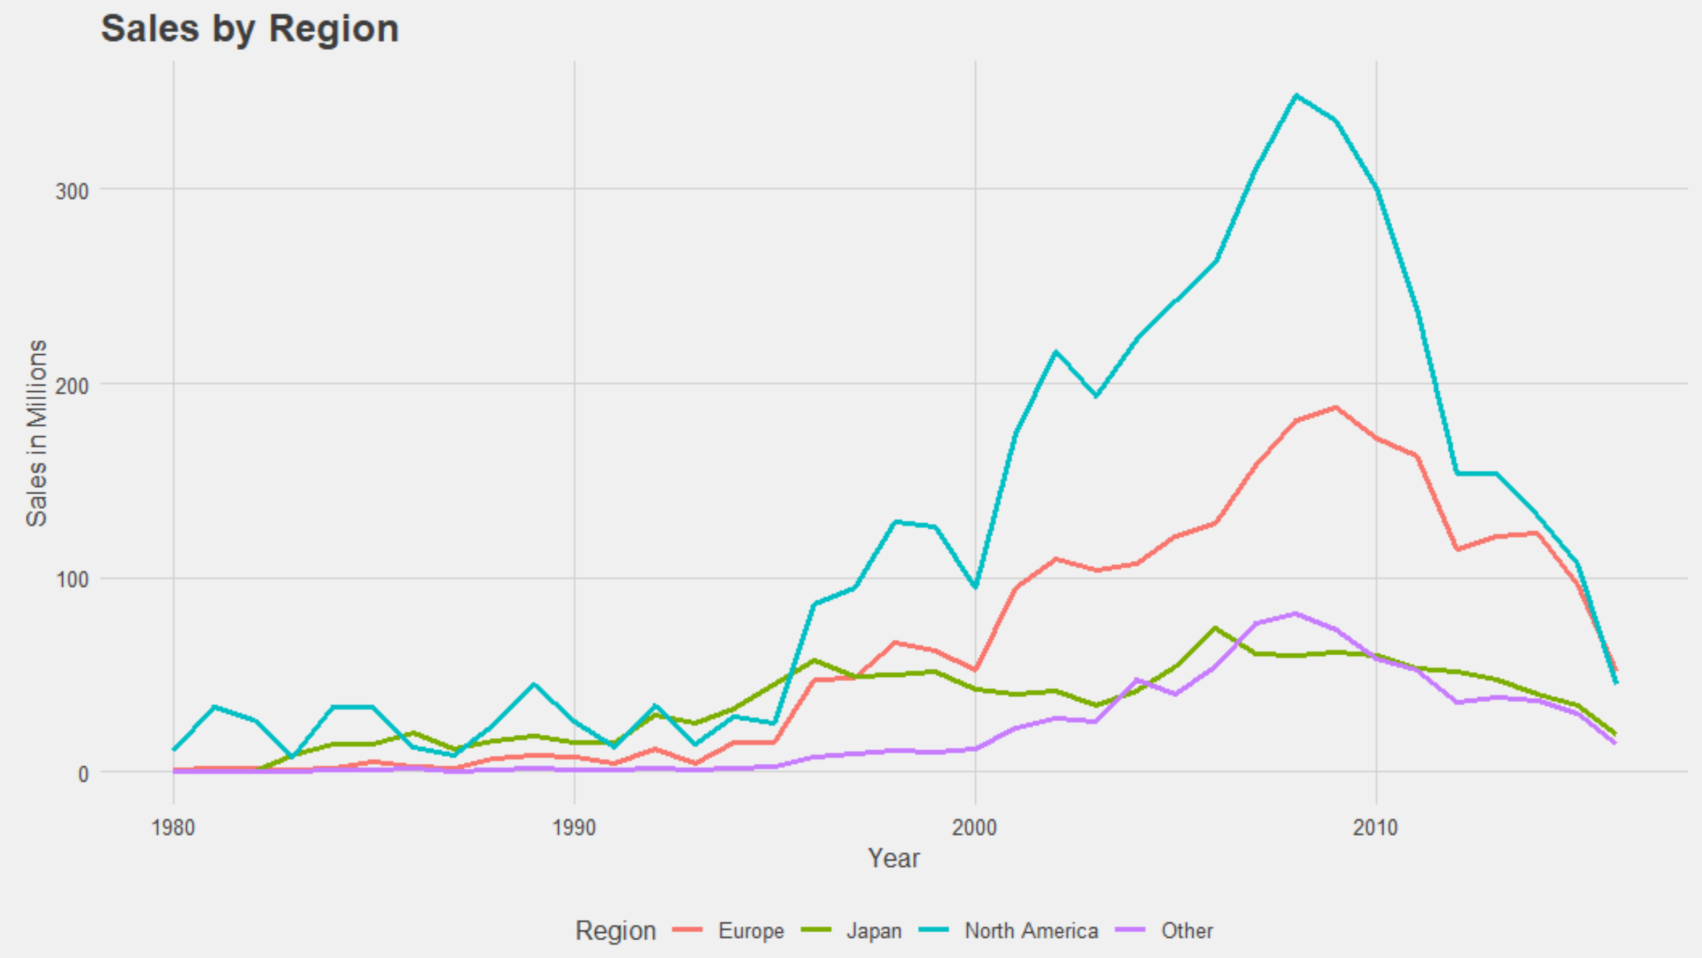
Sales
Critic & Consumer Score
No affect on sales ( r = .18)
No Regional Popularity
Notes:
I created a new variable (cumulative score). That multiple the consumer score by 10 (from a 1-10 to 10-100 scale) to be the same as critic score. Then I averaged the two to create a cumulative score. There is no correlation between game review score and sales. Sales could be due to heavy advertising, brand name loyalty, console or publisher reputation, or other factors. In the sales by region graph, I expected to see a peak in Japan when Mario or Pokemon was released, but instead the games were popular worldwide.

Slide 5

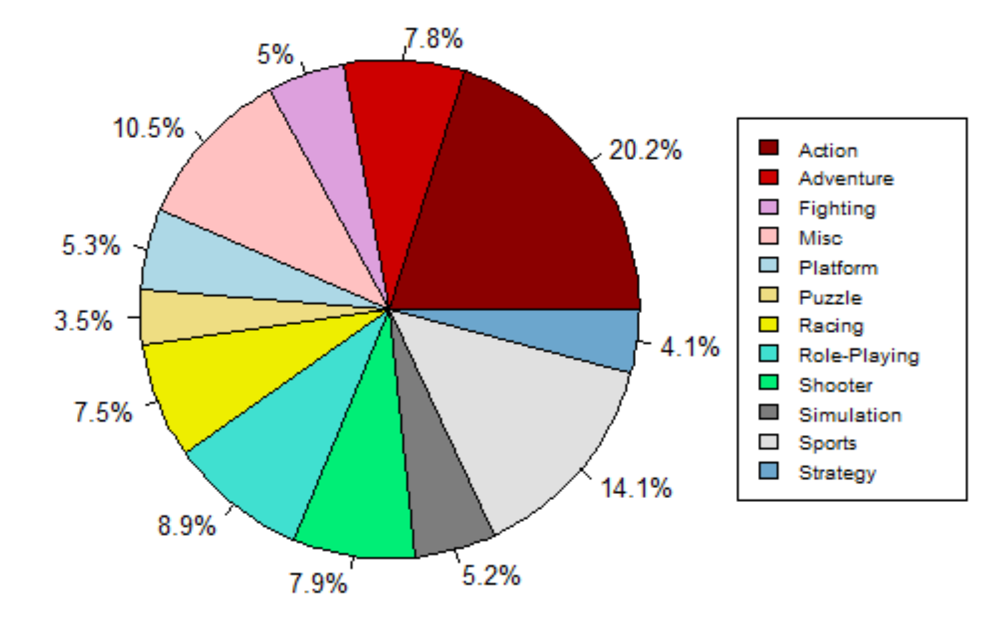
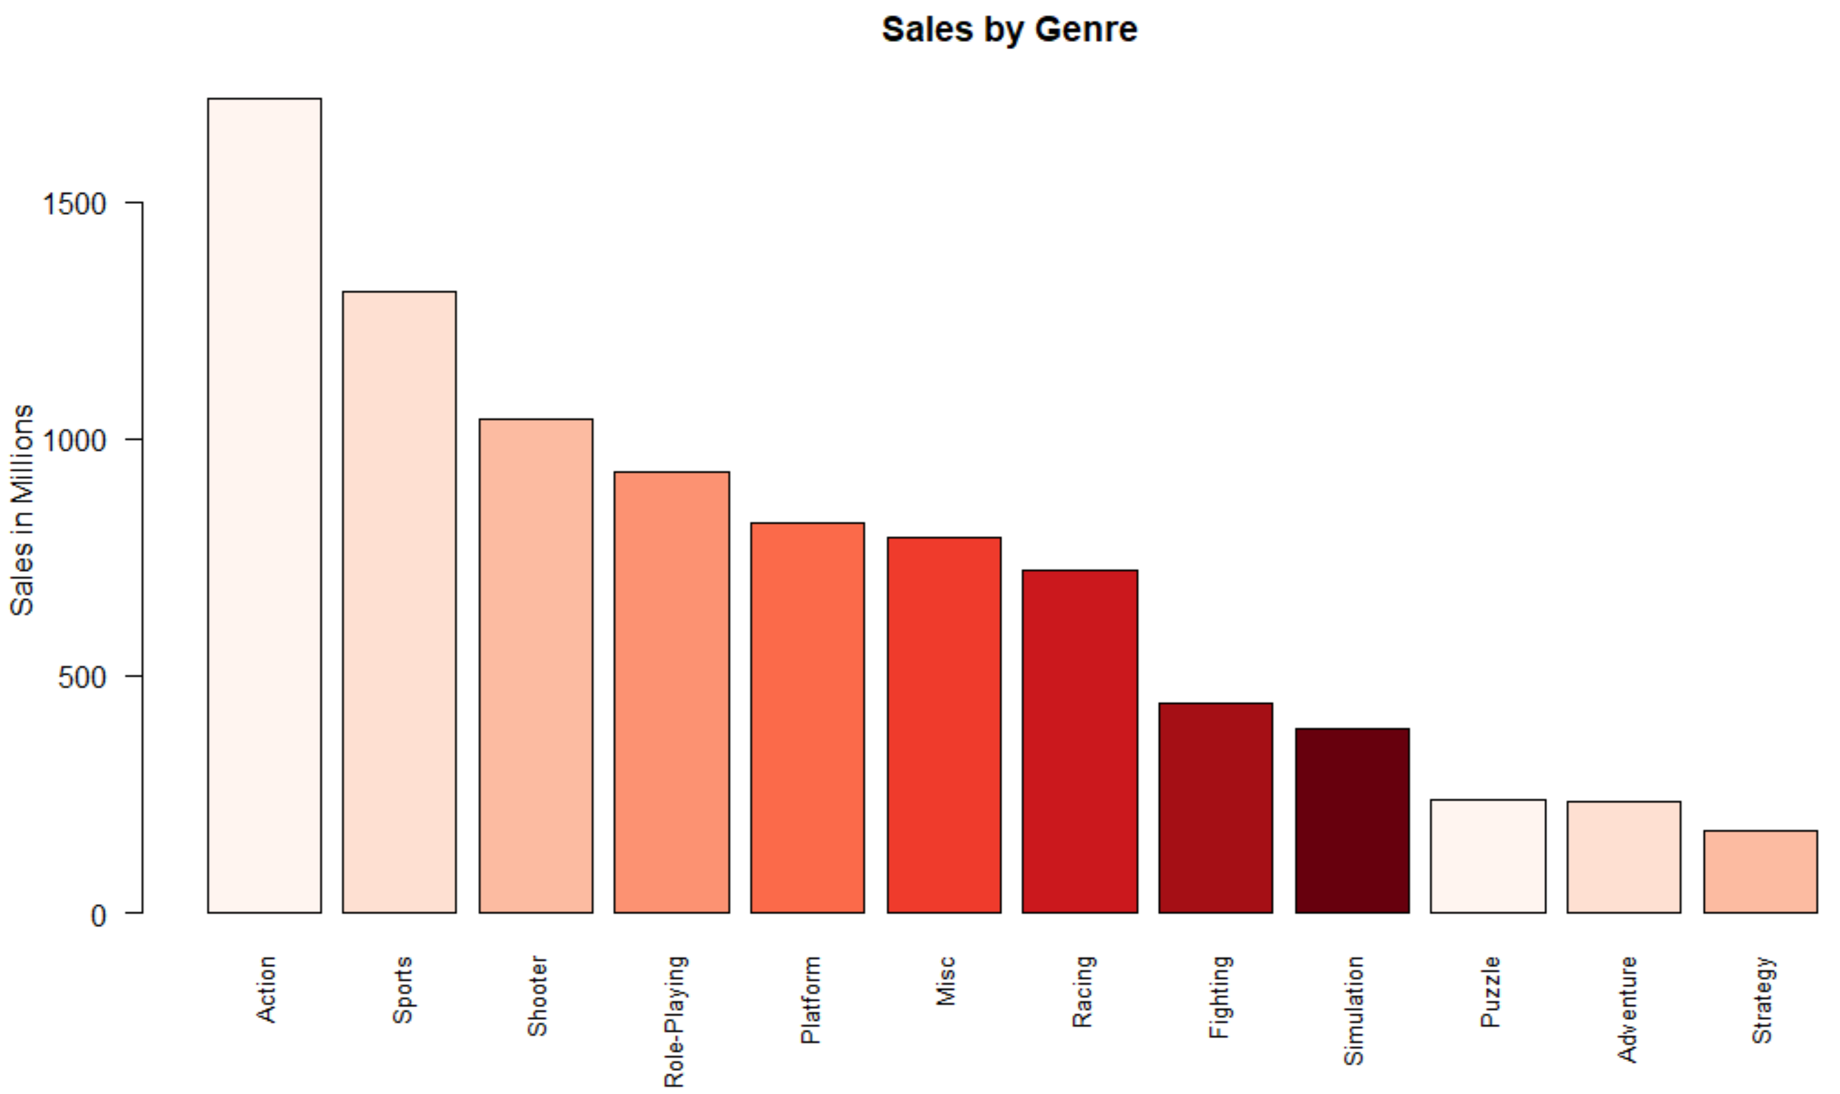
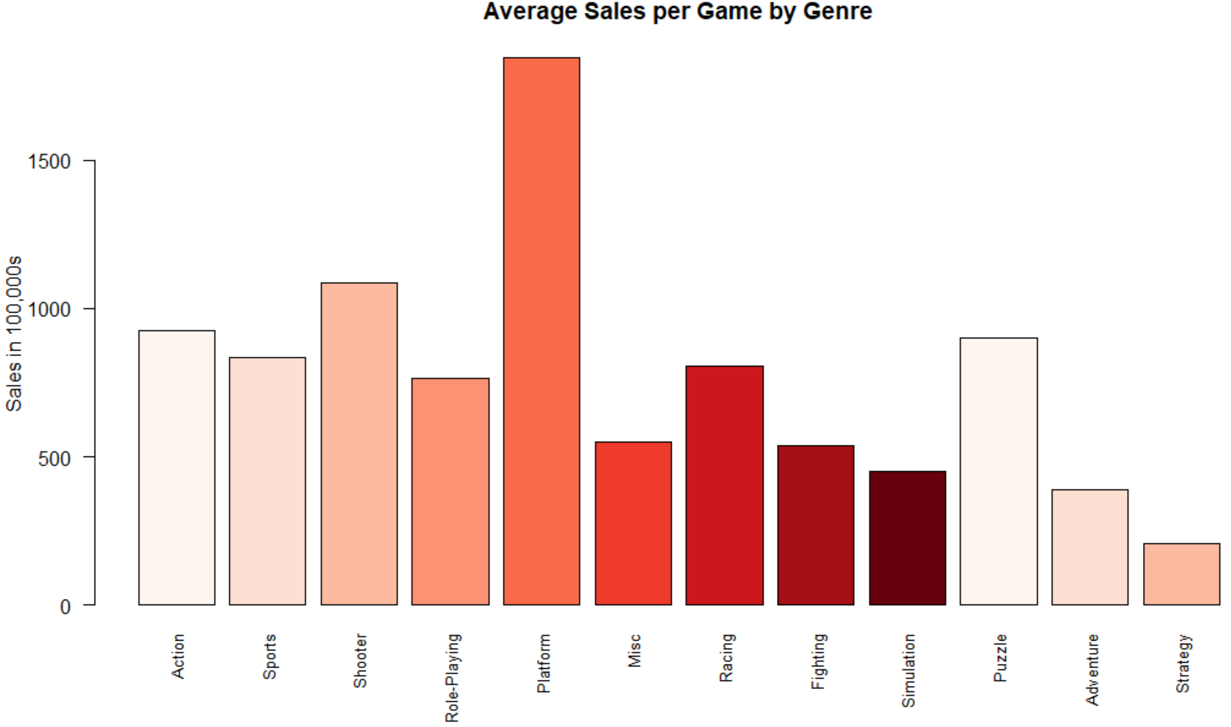
Genres
Sonic and Mario franchises skew Platform profitability
Notes:
My data includes a fairly even distribution of games by genre. It is fascinating to see how Marion and Sonic dominated the Platform genre based on the second graph.

Slide 6
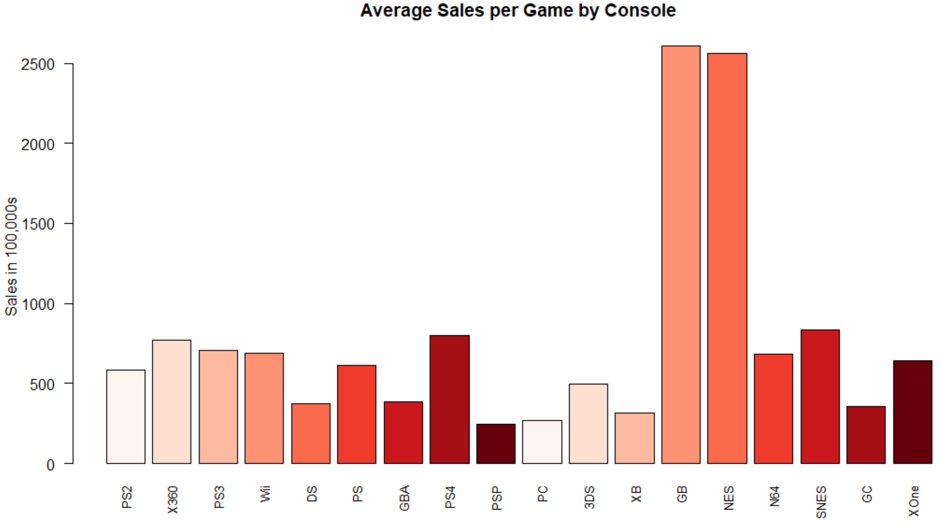
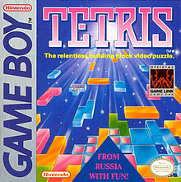



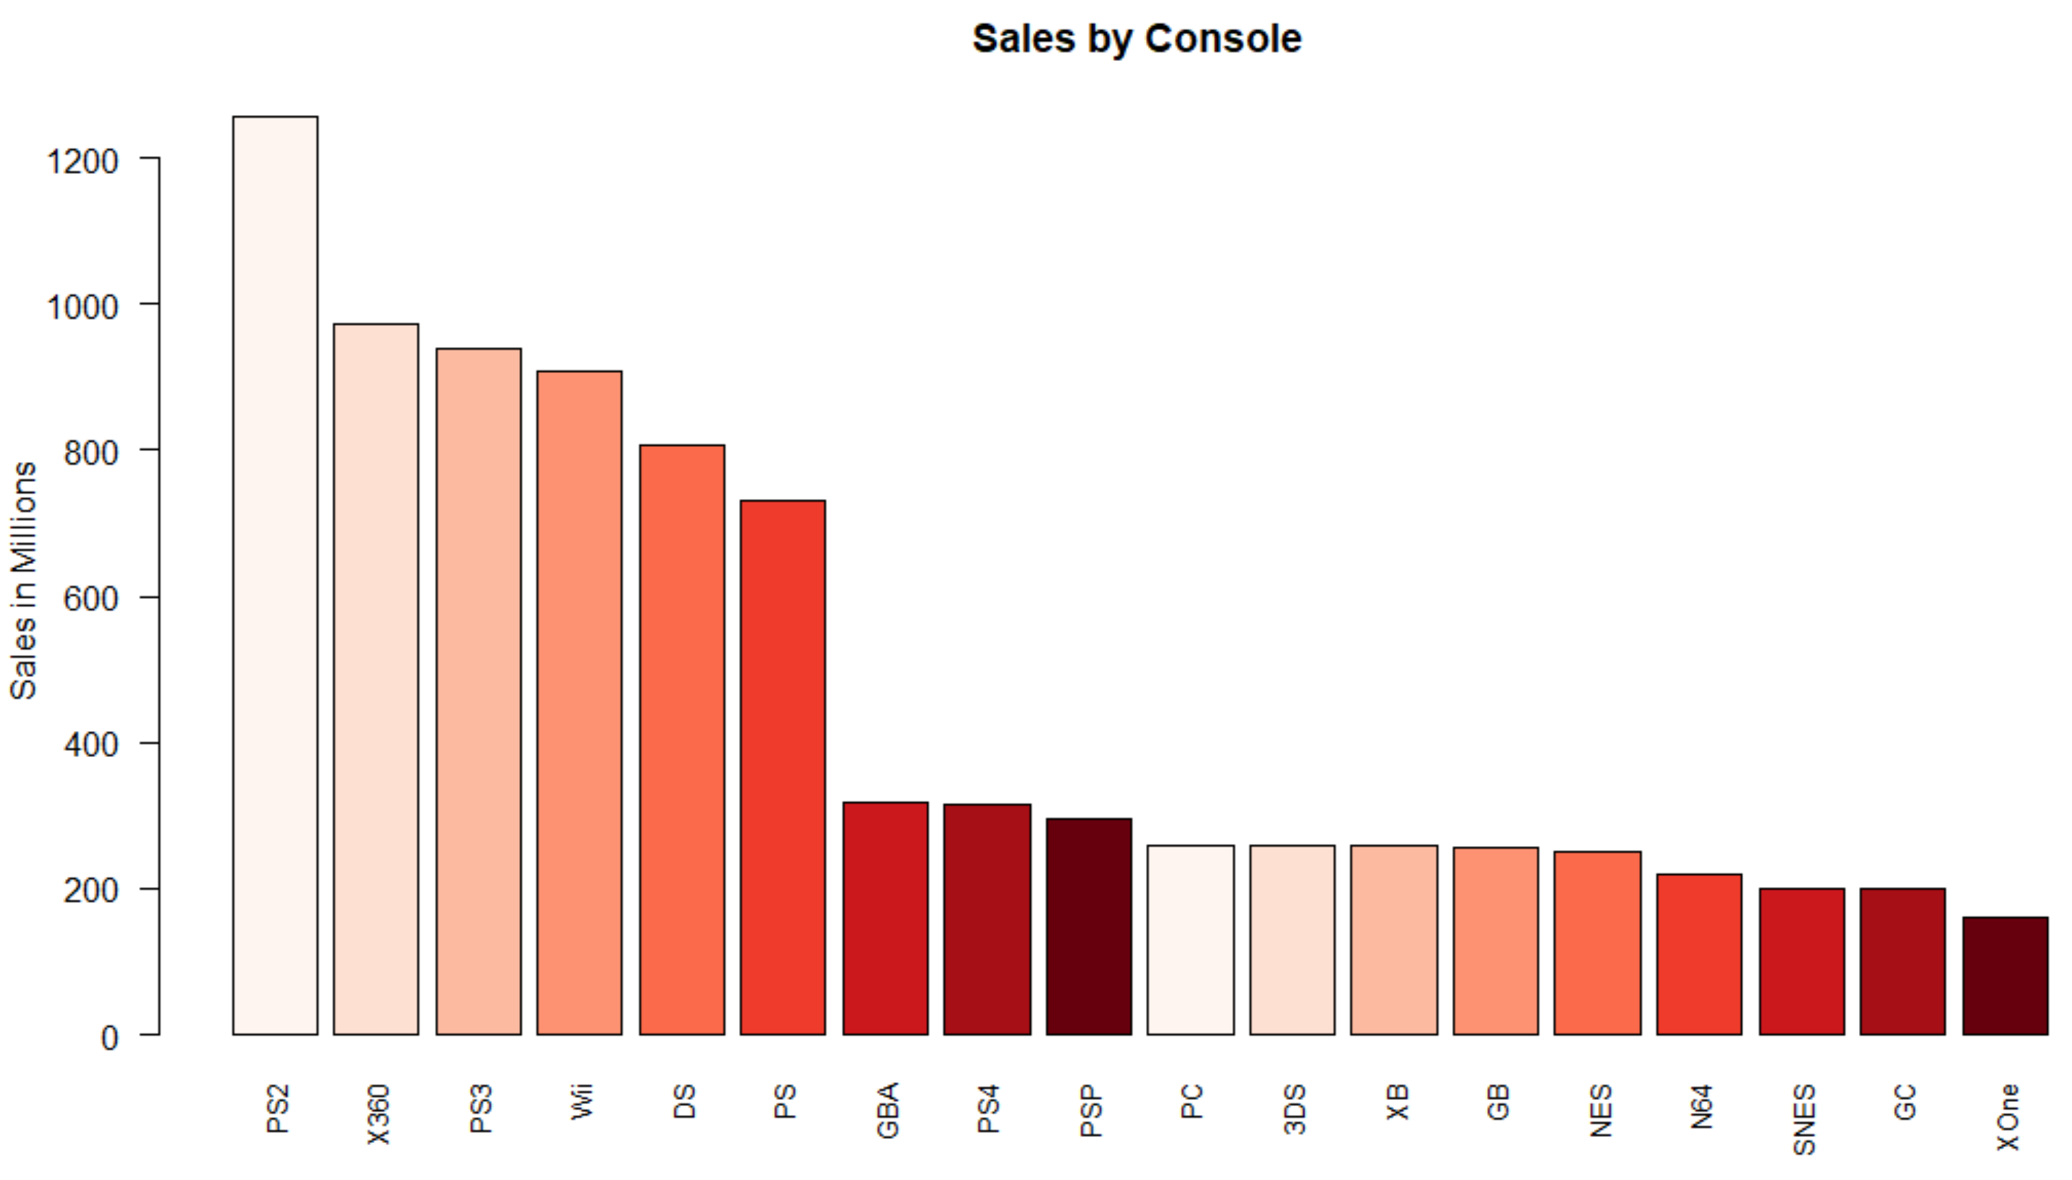




Console
Notes:
Gamers seemed to be loyal to their favorite game franchises, such as Mario and Pokemon, hence the significant profitability of Gameboy and NES consoles. Also Nintendo is in a unique position where they are a console creator and game publisher. Combine that with their reputation of popular games and their console profitability soars

Slide 7
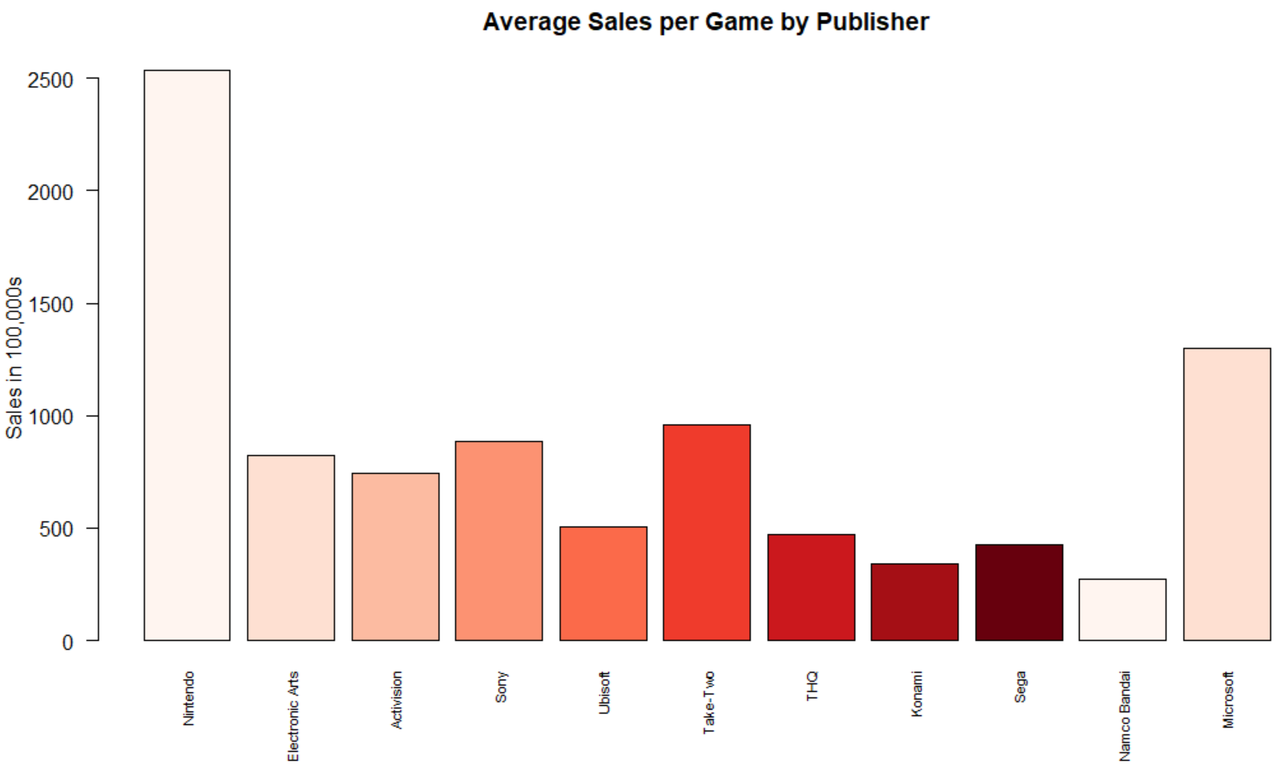


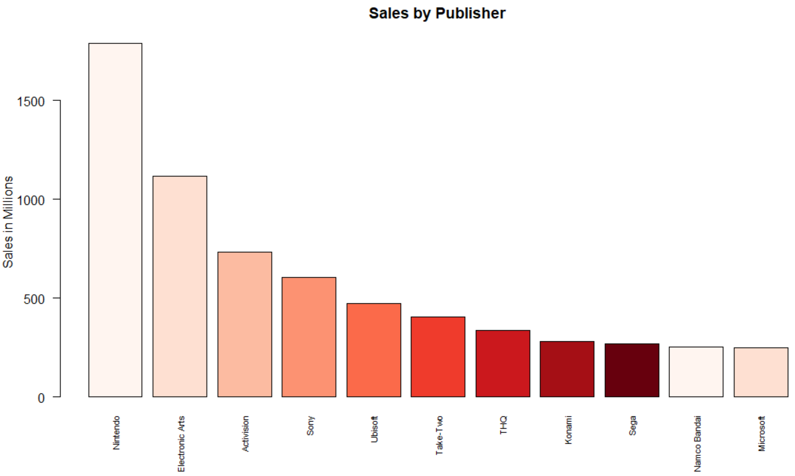


Publisher
Notes:
We see again a few big hits skew the data. Nintendo has Mario, Pokemon that are incredibly popular. EA has had success with sports games, but are stuck in a yearly release cycle which does not tend to be as profitable on average. Microsoft has Minecraft that contributes to their high profitability despite mediocre sales

Slide 8
Summary
Increased competition reduces profitability
Business model changing
Few big hits, many failures
80/20 rule
Critic & Consumer review do not impact sales
Snowball effect
Reputation
Notes:
1995 inflection point, many more games released, slightly more sales = less profitability
Business model is changing from games selling at full price to microtransactions, thus a slight decrease in apparent revenue approaching 2016. Many games are cheap or free to download, but offer many individual player upgrades or items for small prices. Fortnite has proven this to be a profitable business model. If I were to analyze this data past 2016, I would need total revenue, nut just sales of each game at checkout
There are a few popular games that many people know if, but for every hit there are at least 10 failures of games that did not breakeven.
80% of the people play 20% of the games (pareto’s principle)
Since reviews do not impact sales, I would consider looking into factors such as marketing budgets, brand loyalty, or peer to peer reviews. Do people only play games their friends play? There can be an easy snowball affect

Slide 9

?

Slide 10
Citations
Kabacoff, Robert. R In Action: Data Analysis and Graphics with R. Manning, 2015.
Bluman, Allan G. Elementary Statistics: a Step by Step Approach. McGraw-Hill Education, 2018.
Guest, et al. “R Is Not So Hard! A Tutorial, Part 14: Pie Charts.” The Analysis Factor, 3 Nov. 2020, www.theanalysisfactor.com/r-tutorial-part-14/.
Making Pie Charts in R, courses.wccnet.edu/~palay/math160r/makepie.htm.
Ralph. “Summarising Data Using Bar Charts: R-Bloggers.” R, 11 May 2011, www.r-bloggers.com/2009/12/summarising-data-using-bar-charts/.
“Colors in R.” STHDA, www.sthda.com/english/wiki/colors-in-r.
Mangogul 03 Nov 2018 The new columns seem to be only virtual. For example, et al. “Compute and Add New Variables to a Data Frame in R.” Datanovia, 18 July 2019, www.datanovia.com/en/lessons/compute-and-add-new-variables-to-a-data-frame-in-r/.
JuddyJuddy 26911 gold badge22 silver badges77 bronze badges, et al. “Re-Ordering Bars in R's Barplot().” Stack Overflow, 1 Apr. 1965, stackoverflow.com/questions/37480949/re-ordering-bars-in-rs-barplot.
Mark MillerMark Miller 11.1k2121 gold badges6969 silver badges115115 bronze badges, et al. “Remove Grid, Background Color, and Top and Right Borders from ggplot2.” Stack Overflow, 1 Apr. 1961, stackoverflow.com/questions/10861773/remove-grid-background-color-and-top-and-right-borders-from-ggplot2.

